Slide 1

Gear Train
By: Brett Harden

Slide 2

Contents
Definition & Purpose
Theory
Relevance/Design

Slide 3
What is a gear train?
Definition:
Mechanical device where two or more gears are made to mesh with each other to transmit power from one shaft to another.
Purposes
Mechanical Advantage
Mechanical Conversion
Angular Velocity control

Slide 4

Theory

Slide 5
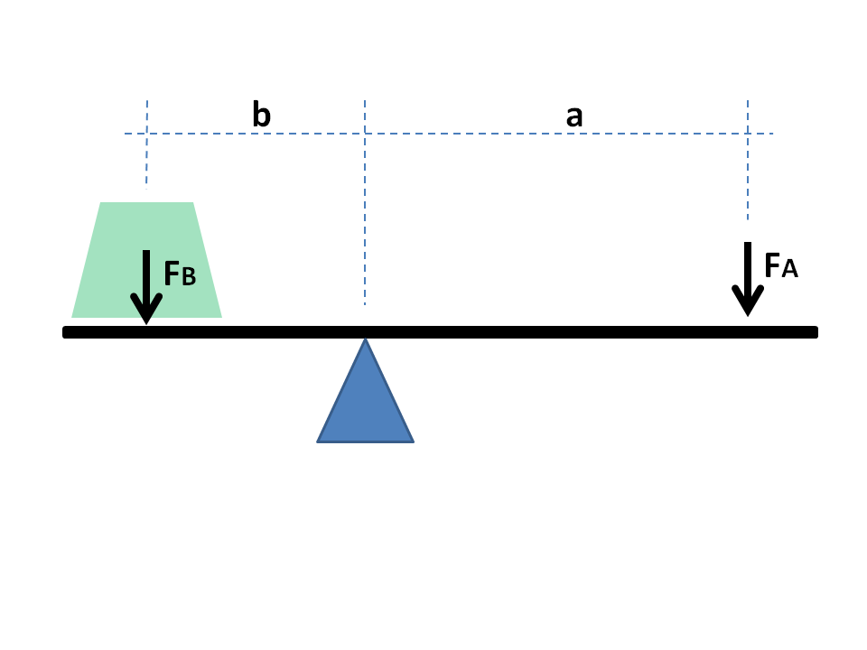

Mechanical Advantage
Force amplification achieved by devices
Mechanical conversion of Forces
Simplest form: lever
$\frac{FB}{FA}=\frac{a}{b}$

Slide 6
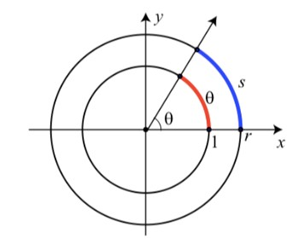

Linear vs. Angular Position
Relationship
$s=rθ$
Key
s = Arc length
r = Radius
$θ$ = Radians

Slide 7
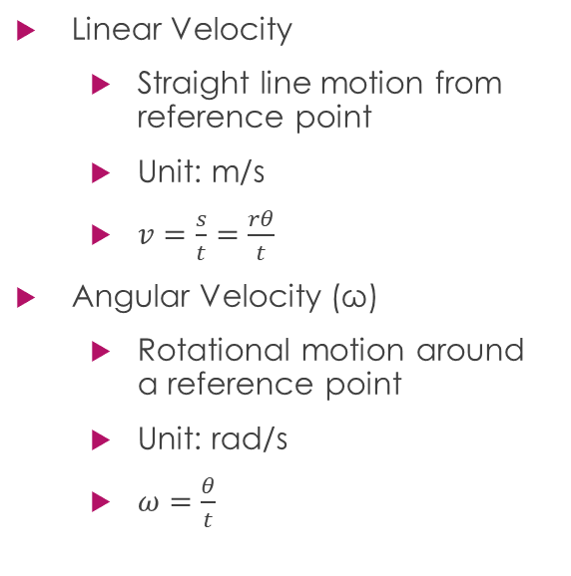
Linear vs. Angular Velocity
Linear Velocity
Straight line motion from reference point
Unit: m/s
$v=\frac{s}{t}=\frac{rθ}{t}$
Angular Velocity (ω)
Rotational motion around a reference point
Unit: rad/s
$ω=\frac{θ}{t}$

Slide 8
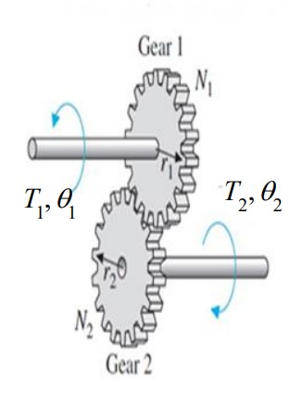

Gear Ratio
Key Components
Torque (T)
Number of teeth (n)
Ratio
$\frac{T2}{T1}=\frac{n1}{n2}$
Same for all components

Slide 9

Gear Train Mechanical Advantage
$Power=torque(T) ×angular velocity(ω)$
Ideal Case
Power in = Power Out
Input Gear > Output Gear
Speed Increases, Torque Decreases
Input Gear < Output Gear
Speed Decreases, Torque Increases

Slide 10

Transfer Function & Analysis
Transfer Function
$\frac{T2}{T1}=−\frac{n1}{n2}$
Negative accounts for direction change between gears
Torque
$T_{out}=−\frac{n_{in}}{n_{out}}T_{in}$
Angular Velocity
$ω_{out}=−\frac{T_{out}}{T_{in}}ω_{in}$
$ω_{out}=−\frac{n_{out}}{n_{in}}ω_{in}$

Slide 11
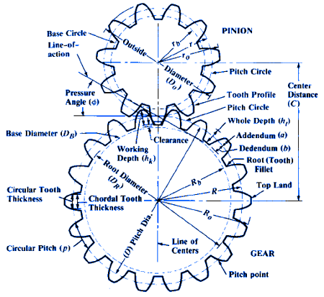
Gear Design Nomenclature

Slide 12
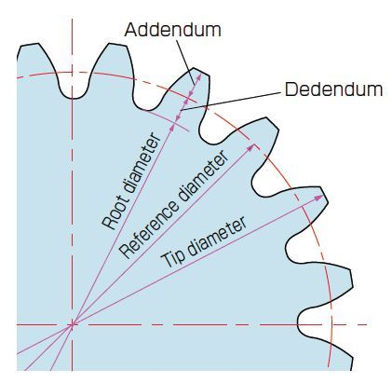
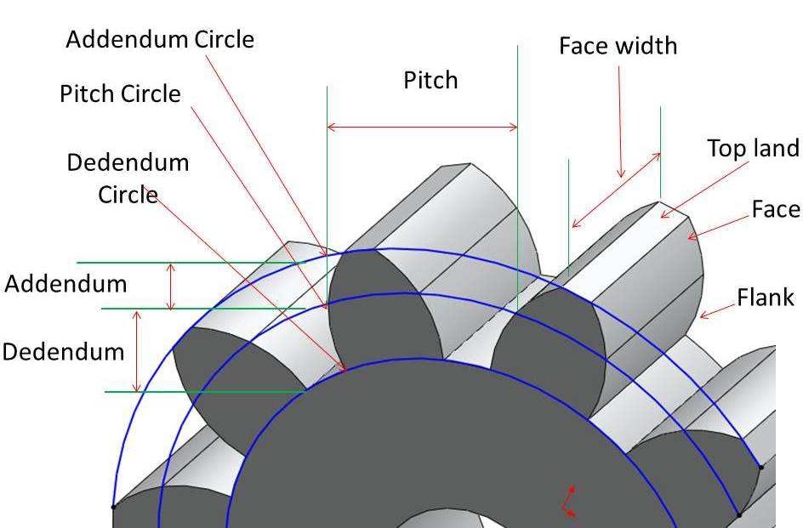
Gear Design Nomenclature

Slide 13
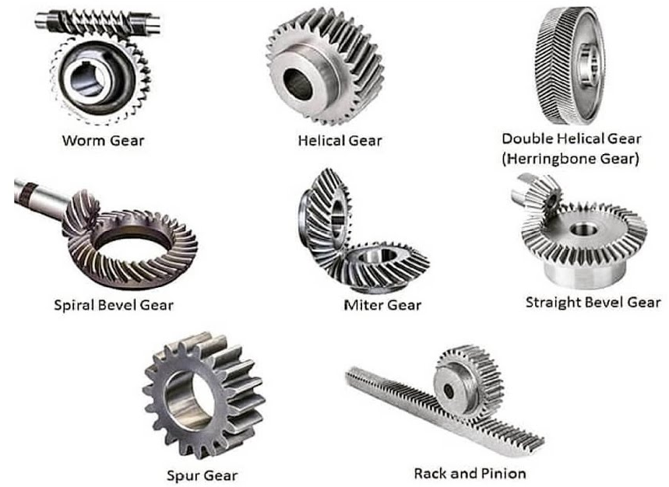
Types

Slide 14

Relevance & Project Design

Slide 15
What’s Needed
Record Steering Wheel Position
Fit inside the car
Physical Rotational Boundary: 960 degrees
Connect the car to an electrical encoder: 360-degree limit*
*Free Spinning. Does not account for full rotations

Slide 16
Design
Encoder Limits: 360 degrees
Car Limits: 960 degrees
8:3 ratio

Slide 17
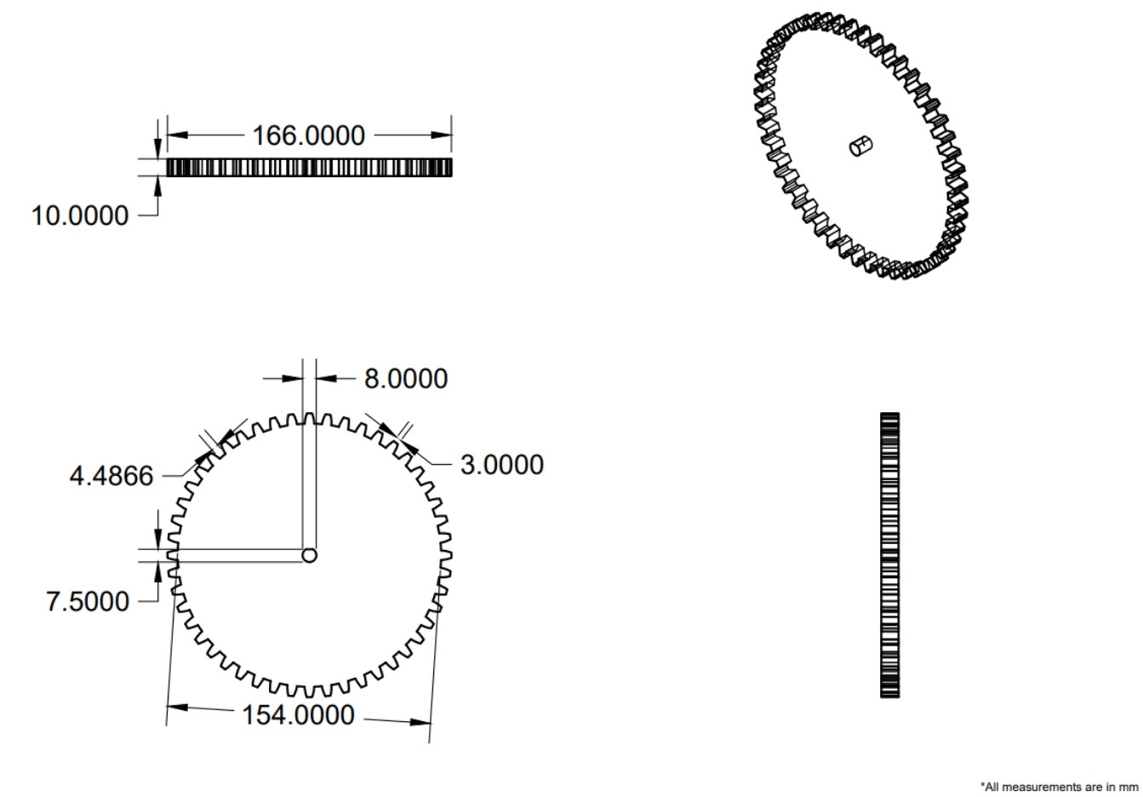
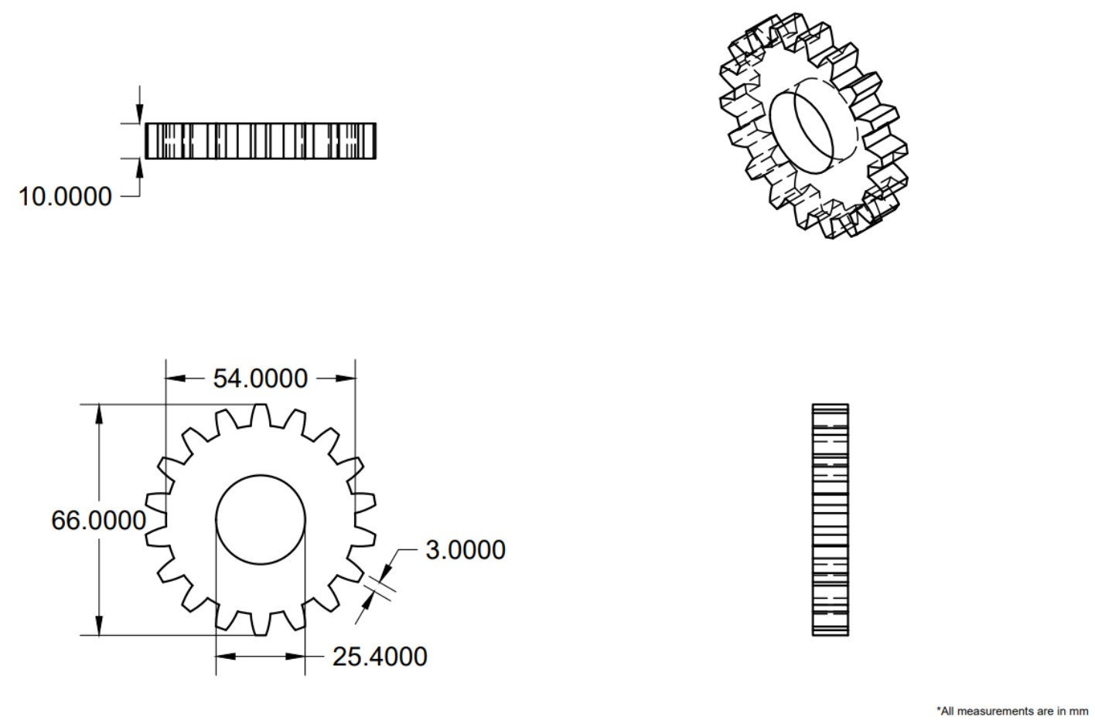
Design

Slide 18
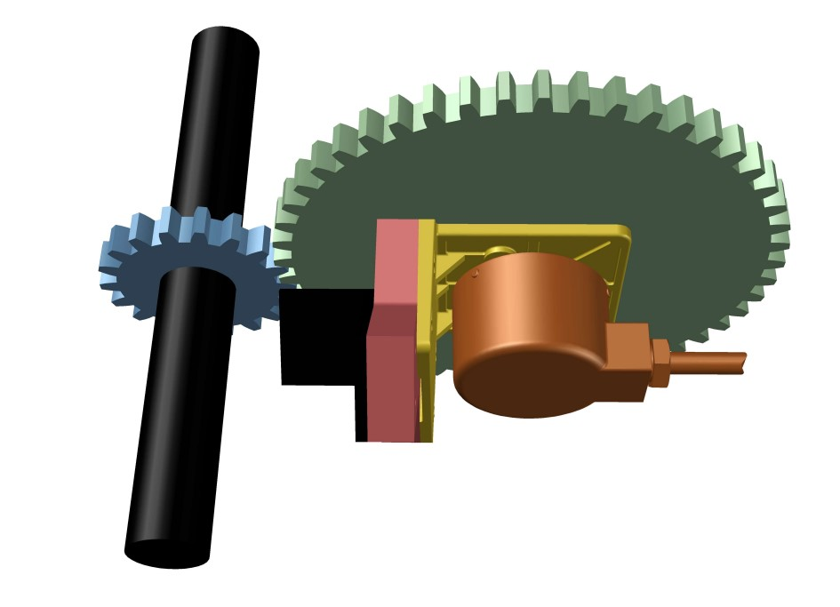
Final Design

Slide 19
References
https://clubtechnical.com/gear-train
https://khkgears.net/new/gear_knowledge/gear_technical_reference/gear-trains.html
https://learnmechanical.com/gear-trains/
https://www.differencebetween.com/difference-between-angular-velocity-and-vs-linear-velocity/
https://math.libretexts.org/Bookshelves/Precalculus/Book%3A_Trigonometry_(Sundstrom_and_Schlicker)/01%3A_The_Trigonometric_Functions/1.04%3A_Velocity_and_Angular_Velocity
https://www.mech4study.com/kom/gear-terminology-basic-defination-used-in-gear.html/

Slide 20
Thank You

